Slide 1
Yelp Restaurant Reviews: Natural Language Processing, Topic Modeling, and Machine Learning with Apache Spark
DATA 603: Big Data
Aaron Tan

Slide 2

5.89 GB and contains 8,021,122 reviews
After filtering, 5,055,992 restaurant reviews
After filtering, 1,256,088 one or five-star restaurant reviews
For greater contrast in modeling
Example:
[Row(text='! The food is very tasty! Every dish we have savored with my family has been simply spectacular! Totally delighted with this place!\n Oysters and aguachiles !! Omg a delight !!!', stars='5.0', categoryIndex=1.0)]
To make it computationally tractable on my local machine, I worked with 25% of this filtered data, 314,693 reviews, or ~4% of the original dataset, or ~230 MB
Not 500 MB, but NLP processing is very computationally expensive

Slide 3
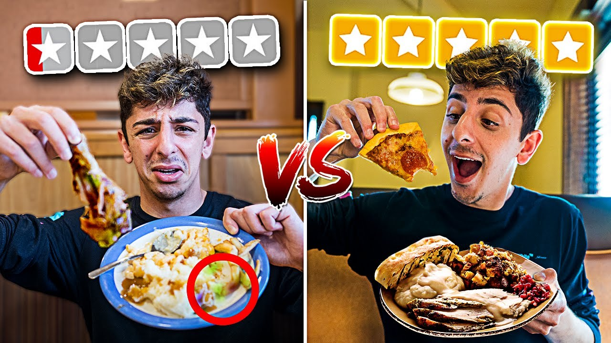
Research Question: What linguistic features are associated with one vs. five-star restaurant reviews?
If successful, this model should output meaningful, insightful, and salient features that could aid restaurant owners in making changes to avoid getting one-star reviews and acquire more five-star reviews.

Slide 4
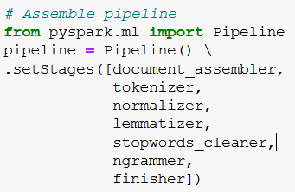
NLP Preprocessing
Tokenization
Normalization
Lemmatization
Stopword removal
Unigram + bigram model
Finisher

Slide 5
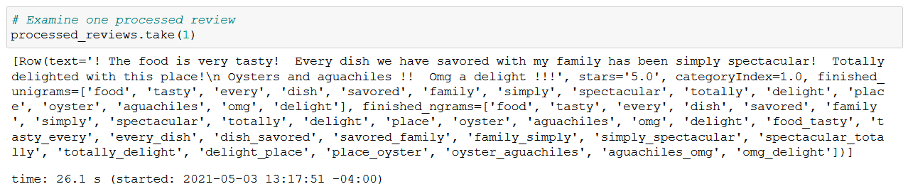
Example of a Preprocessed Review

Slide 6
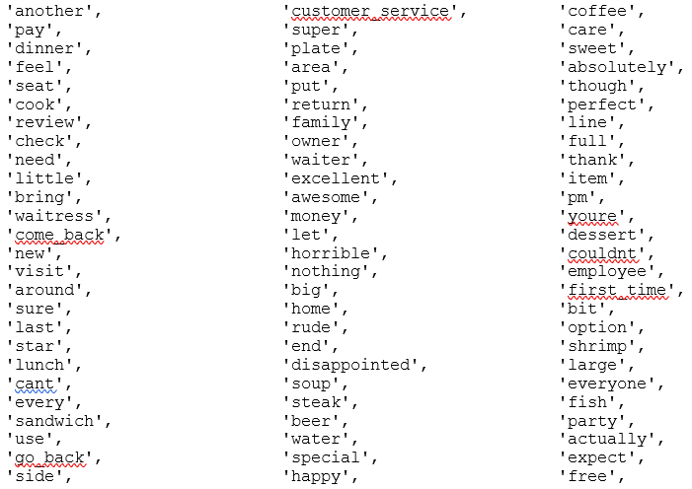
Vectorization
Count vectorization
minDF = 0.01, maxDF = 0.1 to exclude tokens that are too common and not useful (e.g., tasty) or too esoteric
Term Frequency-Inverse Document Frequency
“The TF–IDF value increases proportionally to the number of times a word appears in the document and is offset by the number of documents in the corpus that contain the word, which helps to adjust for the fact that some words appear more frequently in general.”
Deweights words in proportion to how many documents they appear in
Vocabulary size = 787

Slide 7
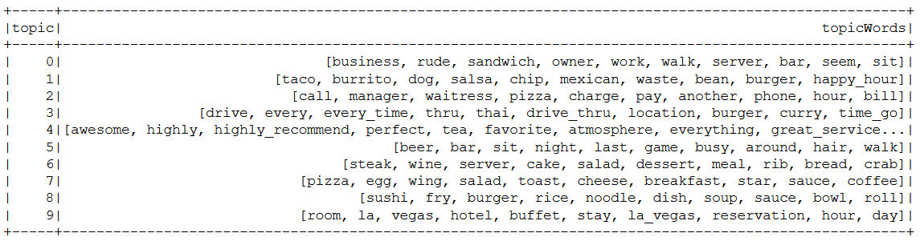
Exploratory LDA Topic Modeling
10 topics
Not very useful since topics are not correlated with one vs. five-star reviews

Slide 8
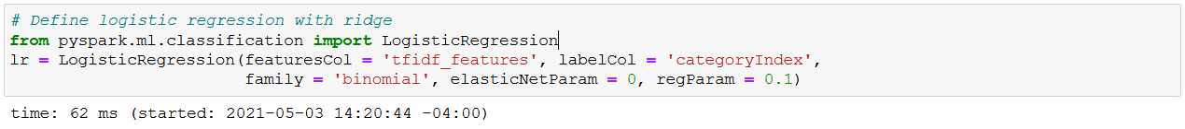
Logistic Regression
Greatest and smallest beta coefficients for each token feature should correspond to the tokens associated with predicting one vs. five-star reviews
80-20 train-test split
94% train accuracy, 94% test accuracy – model appears to work, not overfitting on training data

Slide 9
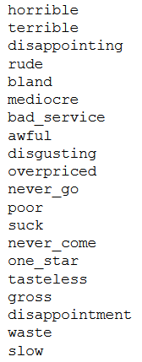
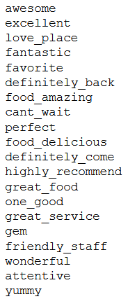
Results
Ordered by beta coefficient value
Left: Tokens associated with one-star reviews
Right: Tokens associated with five-star reviews

Slide 10
Random Forest
Feature importances should similarly correspond to the tokens associated with predicting one vs. five-star reviews
Default settings: maxDepth = 5, numTrees = 20
81% train accuracy, 81% test accuracy – not as accurate as the logistic regression model

Slide 11
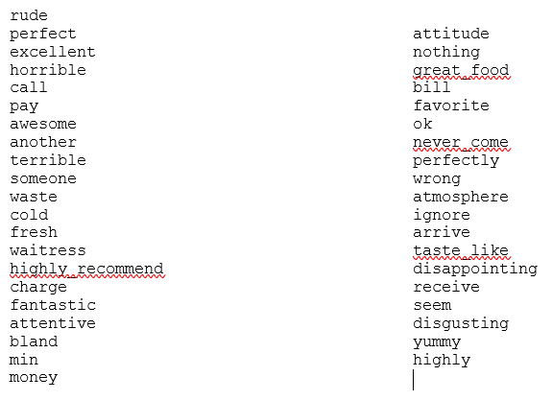
Results
Ordered by feature importance
However, because of the random forest design, there are neutral tokens (e.g., “atmosphere”), and tokens are not explicitly associated with one vs. five-star reviews

Slide 12
Discussion
This project definitely requires distributed computing to complete in full
For only 4% of the original dataset, vectorization takes ~20 minutes, fitting a logistic regression model takes ~10 minutes, random forest takes ~40 minutes
Limitations
The results are still pretty generic. Obviously, a restaurant owner would want to avoid being “horrible” and try being “awesome.” Should continue to play with minDF and maxDF
Logistic regression fails to capture the non-linearities of language, random forest has lower accuracy. Could something like LSTM provide similar results?
Future directions
Use POS-tagging to filter out irrelevant bigrams and only keep meaningful phrases and entities
Implement cross validation + grid search to optimize model hyperparameters

